Slide 2
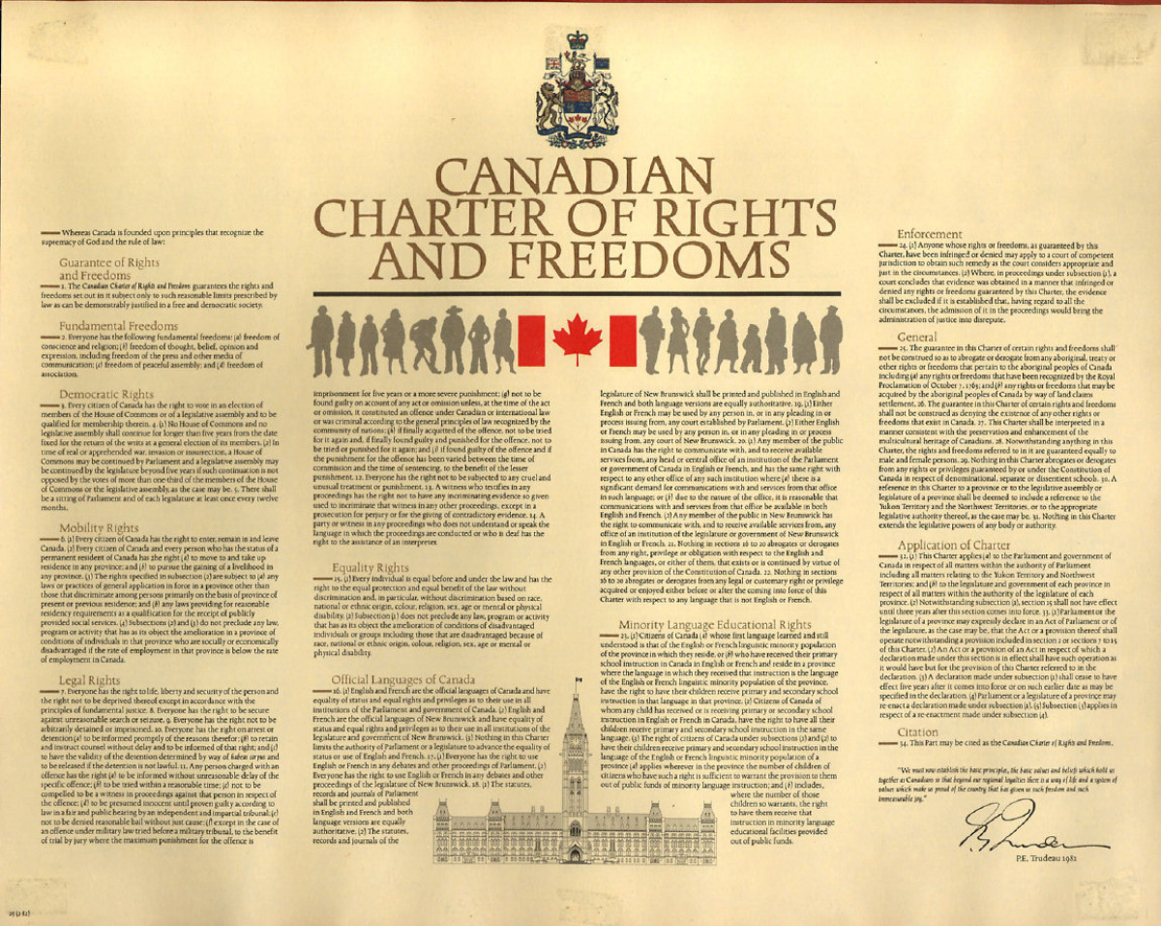
The Canadian Charter of Rights and Freedoms

Slide 3
The Charter of Rights and Freedoms
Replaced the Bill of Rights (which was only legislative not constitutional).
Signed in 1982 under the Liberal Trudeau government.
Disputed by Quebec.

Slide 4
Sections
Limitation clauses
Fundamental Freedoms
Democratic Rights
Mobility Rights
Language Rights
Minority Language Education Rights
Legal Rights
Equality Rights

Slide 5
Guarantee of Rights and Freedoms
1. The Canadian Charter of Rights and Freedoms guarantees the rights and freedoms set out in it subject only to such reasonable limits as can be prescribed by law as can be demonstrably justified in a free and democratic society.

Slide 6
Fundamental Freedoms (s.2)
2. Everyone has the following fundamental freedoms:
a) freedom of conscience and religion;
b) freedom of thought, belief, opinion and expression, including freedom of the press and other media of communication;
c) freedom of peaceful assembly; and
d) freedom of association.

Slide 7
Democratic Rights (s.3-5)
Vote (s.3)
Duration of House (s.4)
Annual meeting of parliament (s.5)

Slide 8
Mobility Rights (s.6)
Citizens: enter, remain in, leave Canada.
Citizens and Permanent Residents: live in and work in any province.

Slide 9
Legal Rights (s.7-14)
Life, liberty, security of person (s.7) – can only be deprived of these “in accordance with principles of fundamental justice”;
Search and seizure (s.8);
Arbitrary detention or imprisonment (s.9);
Arrest or Imprisonment (s.10):
A) informed of charge
B) right to council
C) habeus corpus;
Rights of the accused (s.11):
Lots of things: e.g. innocent until proven guilty, reasonably quick trial;
No cruel or unusual punishment (s.12);
Self-incrimination when testifying against others (s.13);
Interpreter (s.14).

Slide 10
Equality Rights
15. (1) Every individual is equal before and under the law and has the right to the equal protection and equal benefit of the law without discrimination and, in particular, without discrimination based on race, national or ethnic origin, colour, religion, sex, age or mental or physical disability.
15.2 allows for affirmative action programs.

Slide 11
Other Sections
Official Languages of Canada (s.16-22);
Enforcement (s.23) – excludes evidence unlawfully obtained;
General (s.25-31):
Aboriginal treaty rights (s.25);
Other rights allowed (s.26);
Multiculturalism (s.27);
Gender equality (s.28);
Denominational schools (s.29);
Application to territories (s.30);
Does not extend to other legislatures (s.31).

Slide 12
Application of Charter (and citation)
Rights apply to federal and provincial governments only (s.32);
Notwithstanding clause (s.33)
Government can invoke clause that suspends the constitutional rights (2, 7-15) as they apply to a particular piece of legislation
Rarely used – thought to be politically costly
Citation (s.34)

